Slide 1

PROJECT TITLE :JOB PORTAL
DEPARTMENT OF COMPUTER SCIENCE AND ENGINEERING,
SCHOOL OF COMPUTER SCIENCE AND APPLICATIONS
GUIDED BY : MR BHUPENDRA KUMAR SIR
PRESENTED BY
PALLAVI , TANU VED, KHUSHI JAISWAR , LAVI, LALIT KUMAR

Slide 2
INDEX
INTRODUCTION
PURPOSE
TECHNOLOGY
KEY FETURES
HARDWARE/SOFTWARE
ER DIAGRAM
DEMO
FUTURE SCOPE
CONCLUSION

Slide 3
INTRODUCTION
Welcome To Our Presentation On The JOB PORTAL Project, Designed To Connect Job Seekers, Employers, And Administrators In A Streamlined And Efficient Way. This Presentation Will Provide A Detailed Overview Of The Project's Key Features, Functionality, And Target Audience.

Slide 4
PURPOSE
The Purpose Of The JOB PORTAL Is To Streamline The Hiring And Job Application Process, Making It Easier For Job Seekers To Find Employment Opportunities And For Employers To Find Qualified Candidates. The System Aims To Reduce The Time And Effort Spent On Manual Recruitment And Job Hunting Processes, Providing An Efficient And User-friendly Solution.

Slide 5
TECHNOLOGIES USED:
ASP.NET For Server-side Development
SQL Server For Database Management
HTML, CSS, JavaScript For Frontend Development
Bootstrap For Responsive Design

Slide 6
KEY FEATURES OF JOB PORTAL
Admin
Job Seeker
Job Recruiter (Employer)

Slide 7
HARDWARE/SOFTWARE USED
Hardware Requirements: Processor: Intel 64 Hard Disk: 80GB HDD Ram: 512MB and above | Software Requirements: Operating System: Window 11 Front end : HTML, CSS, Bootstrap Database : SQL IDE: Visual Studio, Microsoft SQL Server

Slide 8
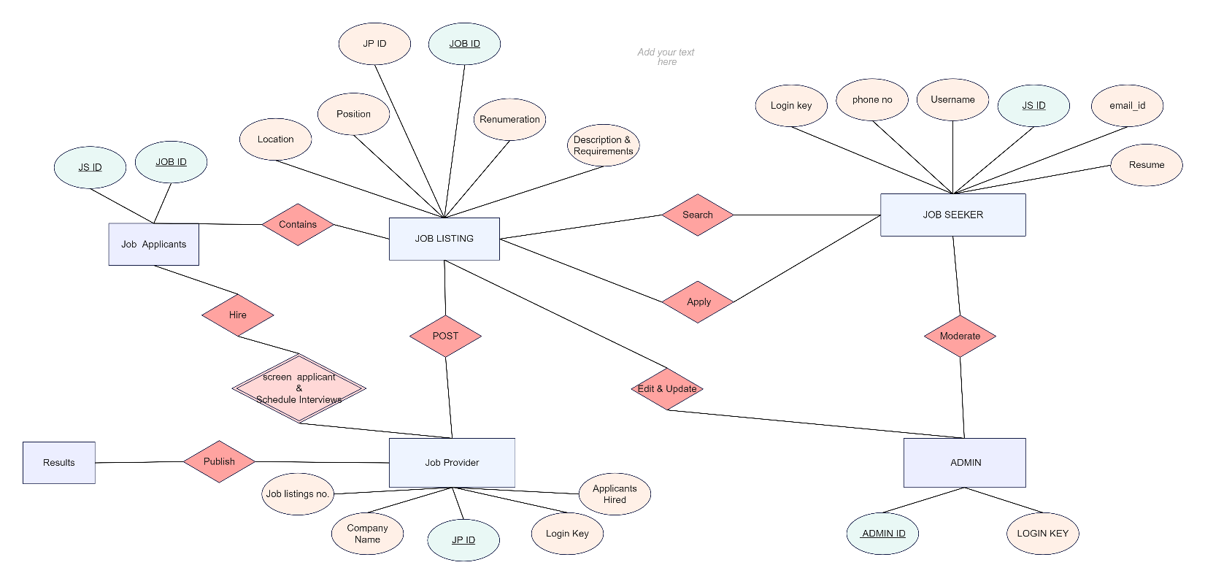
ER DIAGRAM

Slide 9
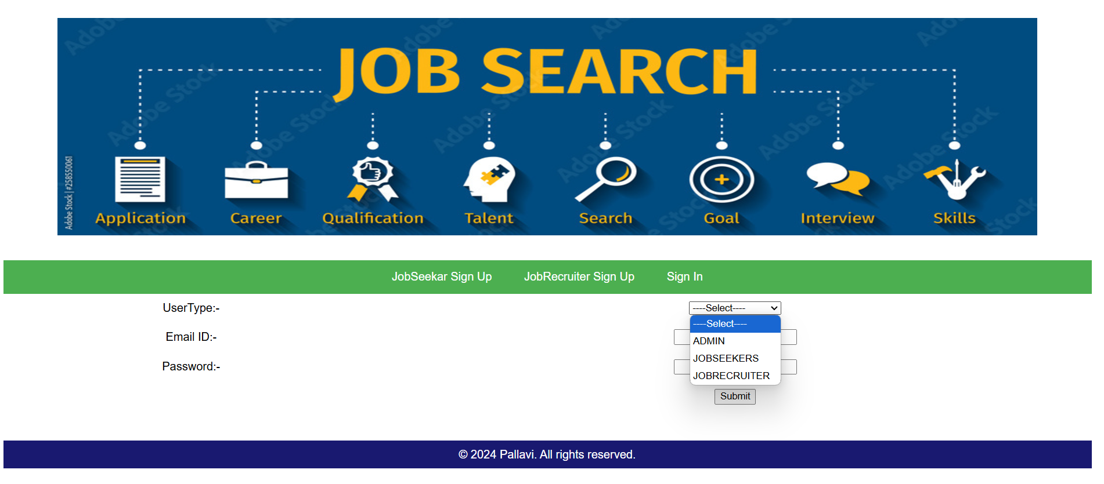
DEMO

Slide 10
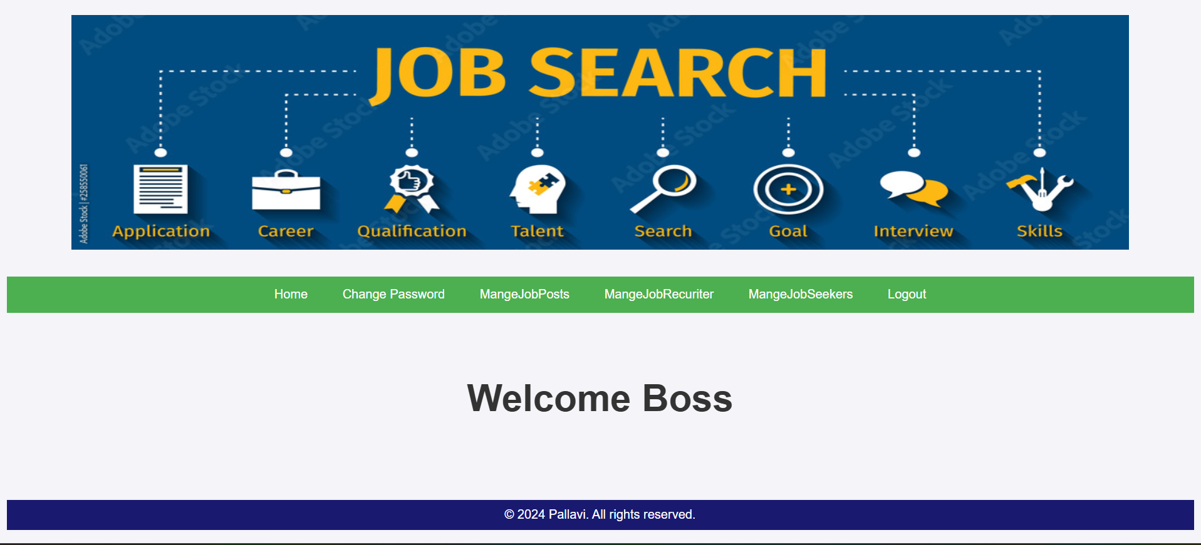
ADMIN PANEL

Slide 11
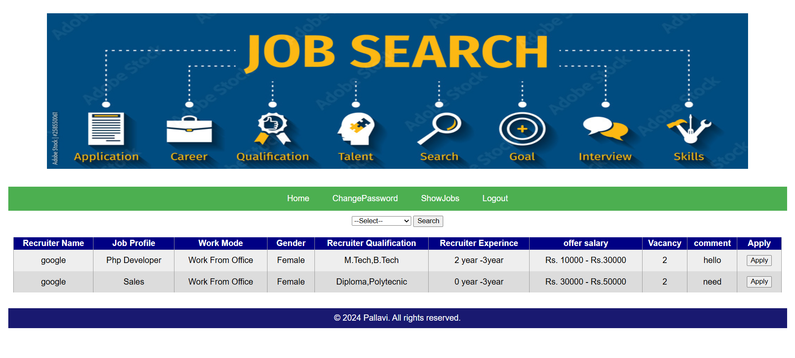
JOBSEEKER PANEL

Slide 12
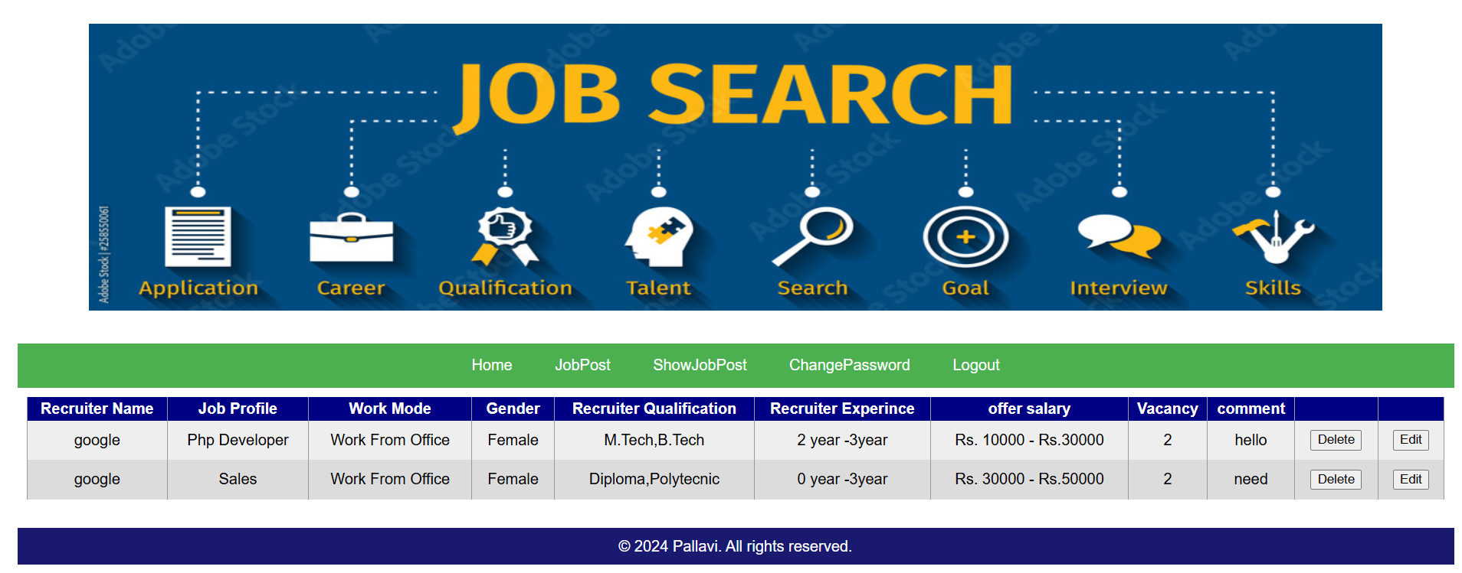
JOBRECURITER PANEL

Slide 13
FUTURE SCOPE
The Future Scope Of JOB PORTAL is Expected To Be Heavily Influenced By Artificial Intelligence (AI), Providing More Personalized And Efficient Job Matching, Deeper Candidate Insights, Advanced Data Analytics, And Seamless Integration With Other Recruitment Tools, Ultimately Streamlining The Job Search Process For Both Employers And Job Seekers While Offering A More User-friendly Experience.

Slide 14
CONCLUSION
Job Matchmaking Is An Important Issue In Today's Global, Distributed, And Heterogeneous Market. We Have Briefly Explored How Available Technology Can Help Improve The Job Recruitment And Job-seeking Processes. We Strongly Believe That, Due To Its High Social Impact, Research In "Job Matchmaking" Should Not Only Aim To Advance Scientific Knowledge But Also Because This Is An Application Area Capable Of Bringing Direct And Immediate Benefits To Humanity.

Slide 15
THANK YOU!

